Slide 1
Journey
Map
Deepthi Peter
Associate Data Engineer

Slide 2
Timeline
Azure Storage Account
4th Sep
Azure Data Factory
6th Sep
Azure SQL with Data Factory
8th Sept
Azure Storage Account Lab
5th Sep
Azure Data Factory Lab
7th Sep

Slide 3
Azure Storage Account (04/09/2023)
Key Learnings:
What is an Azure Storage account?
a unique namespace that contains all of your Azure Storage data objects: blobs, files, queues, and tables
Types of storage accounts - Standard general-purpose v2, Premium block blobs, Premium file share, Premium page blobs
Storage redundancy in Azure – Locally redundant Storage, Zone Redundant Storage, Geo Redundant Storage, Geo Zone Redundant Storage

Slide 4
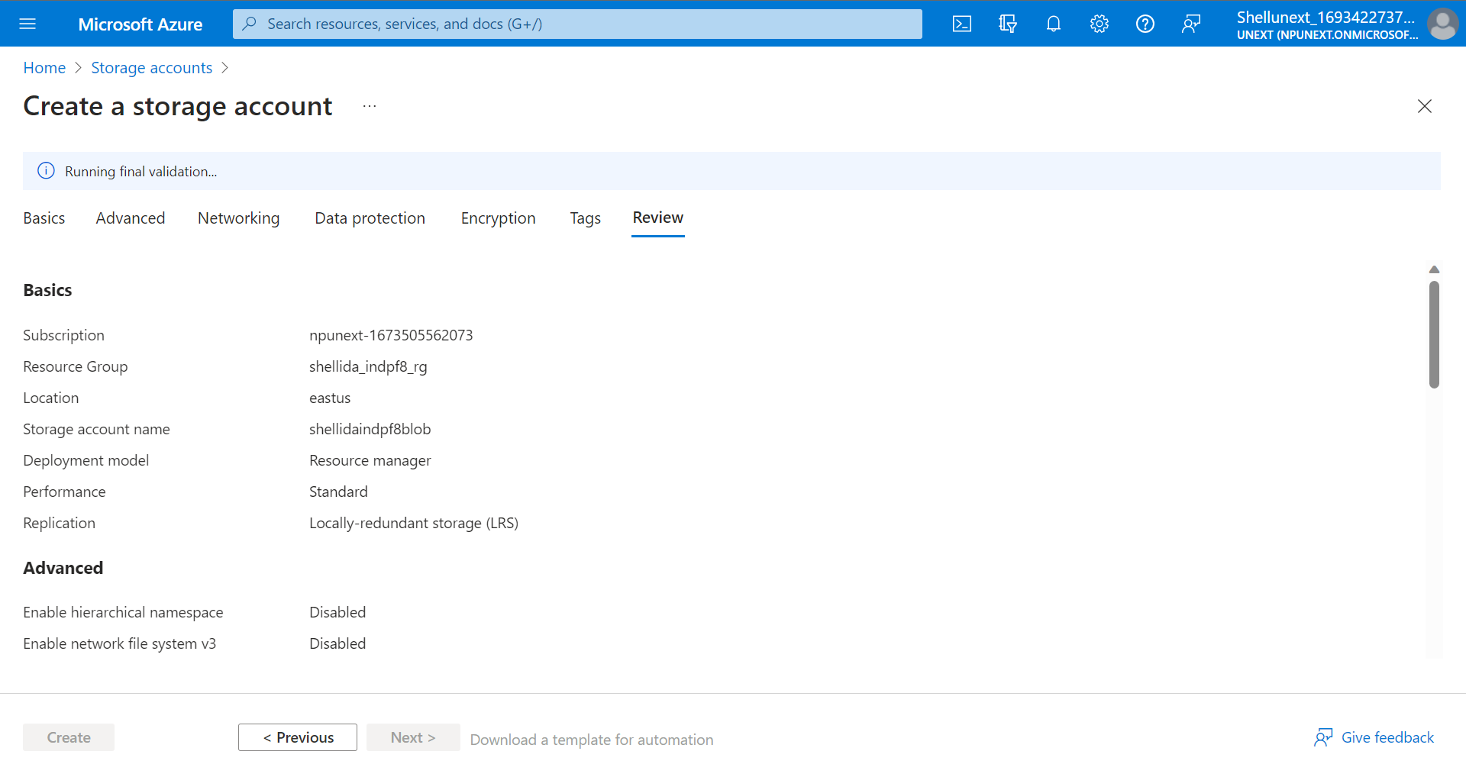
Create an Azure Storage Account

Slide 5
Azure Storage Account (05/09/2023)
Key Learnings:
Azure Blob Storage - To store large amounts of unstructured object data
Create containers on Azure Storage to organize blobs
Azure File Share to mount file shares
Accessing the mounted file share through a Windows VM
Azure Key Vault - a cloud service for securely storing and accessing secrets, such as passwords or API keys

Slide 6
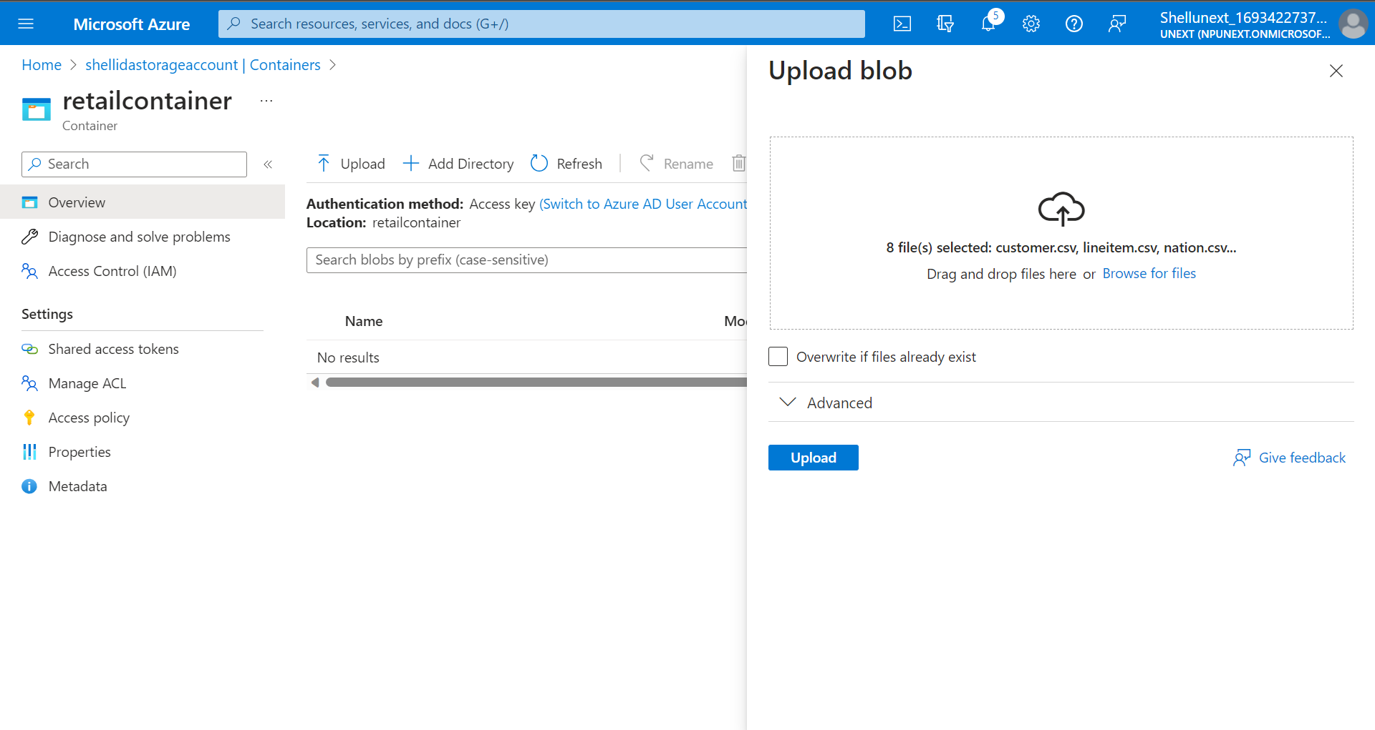
Create a container and upload data in a blob

Slide 7
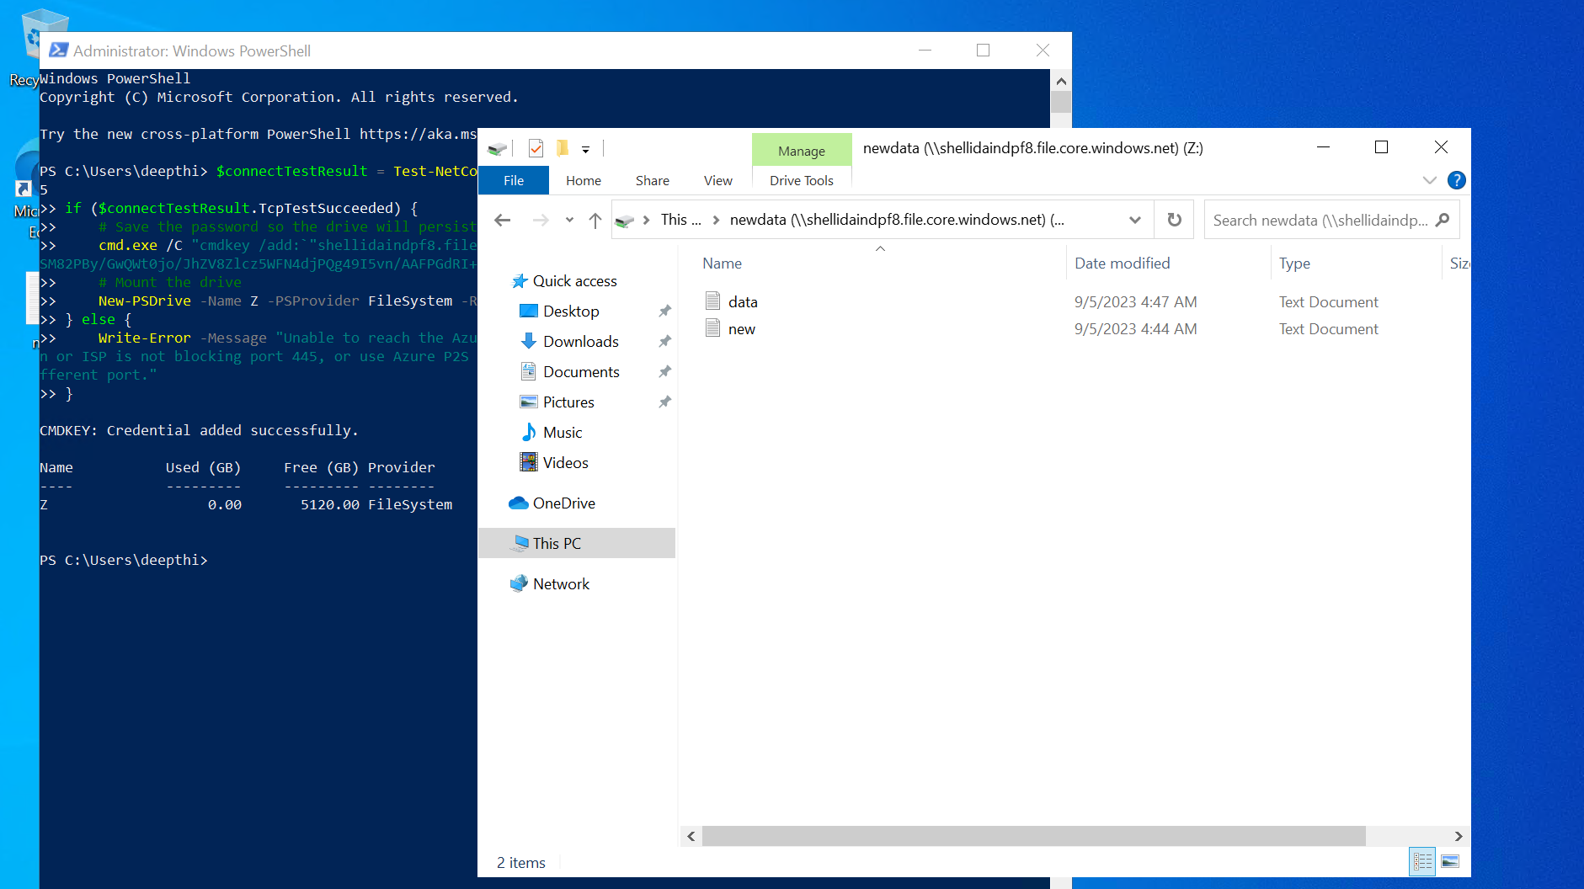
Create a file share

Slide 8
Azure Data Factory (06/09/2023)
Key Learnings:
What is Azure Data Factory?
a series of interconnected systems that provide a complete end-to-end platform for data engineers.
It provides code free ETL services
Pipelines and data flows in Azure Data Factory -
Pipeline is a logical grouping of activities that together perform a task
Data flows are visually designed data transformations in Azure Data Factory

Slide 9
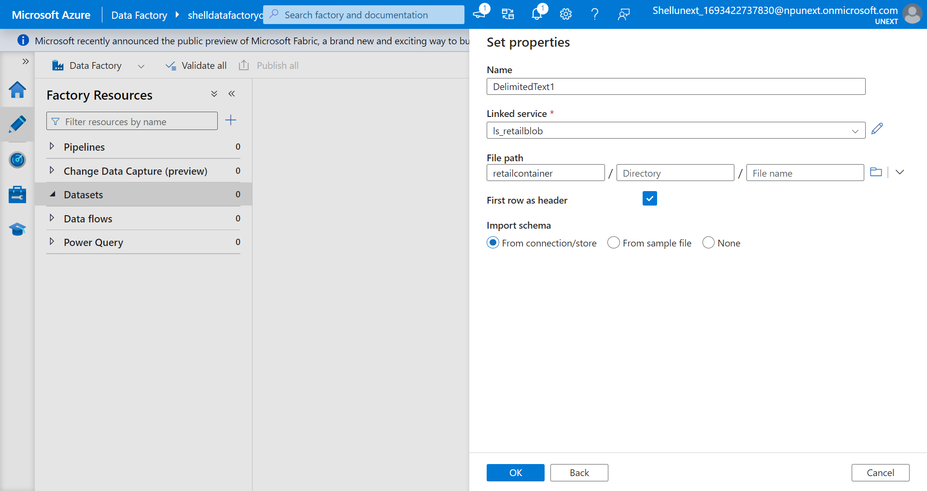
Add a dataset in Data Factory

Slide 10
Azure Data Factory (07/09/2023)
Key Learnings:
ForEach activity
ForEach Activity defines a repeating control flow in an Azure Data Factory pipeline
If Condition
It executes a set of activities when the condition evaluates to true and another set of activities when the condition evaluates to false
Join Condition
Join transformation to combine data from two sources or streams in a mapping data flow

Slide 11
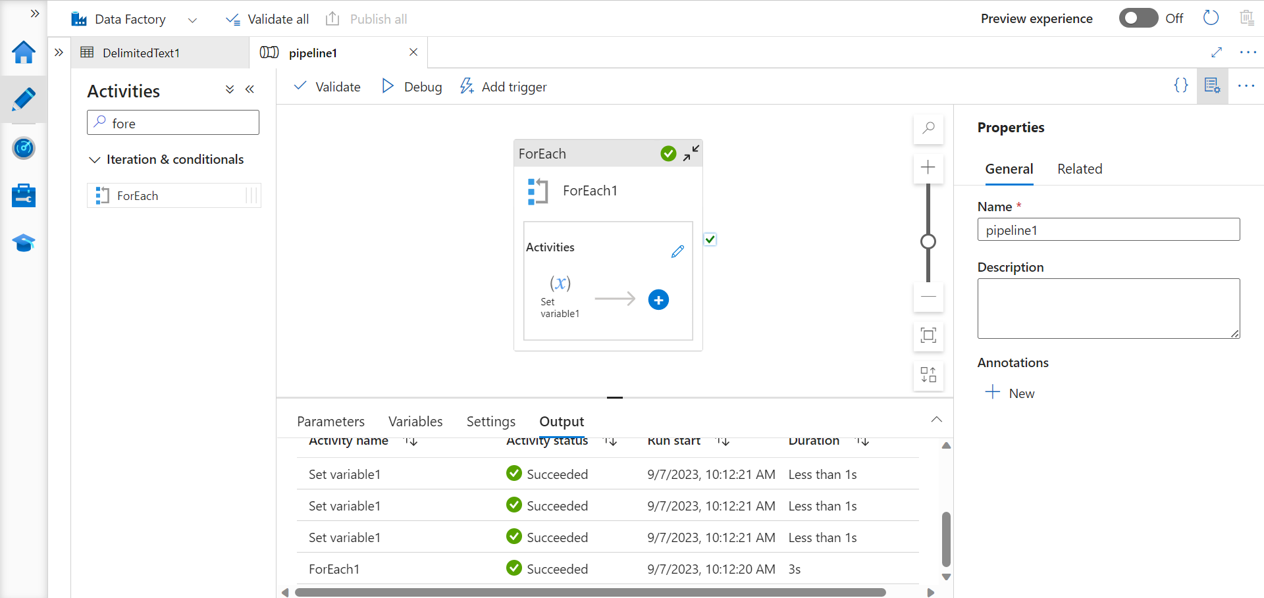
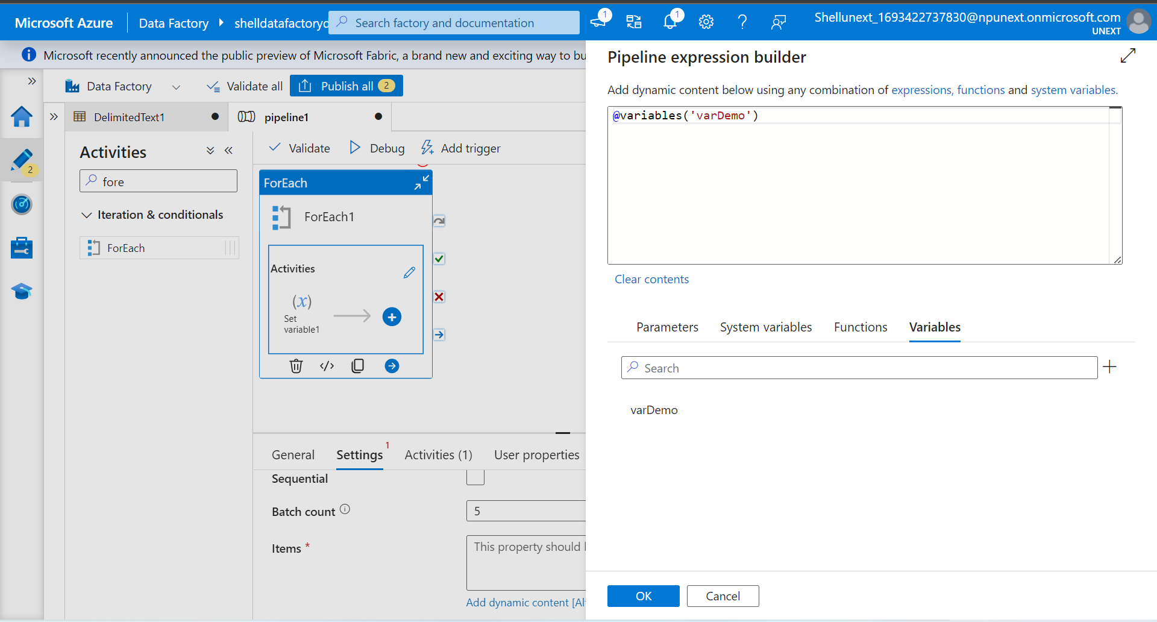
ForEach activity in Azure Data Factory

Slide 12
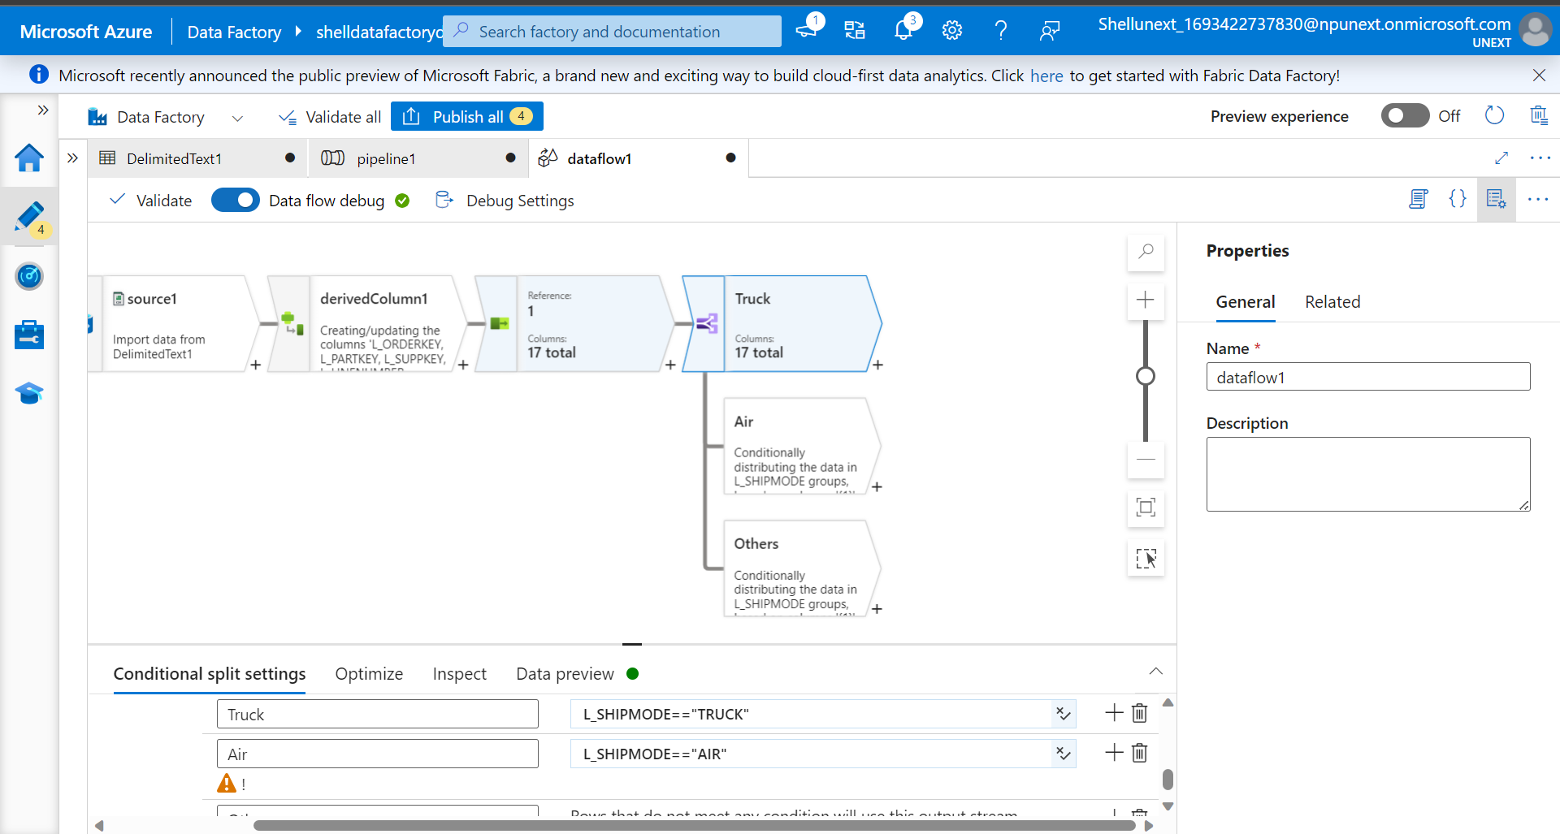
If Conditional Split activity in Azure Data Factory

Slide 13
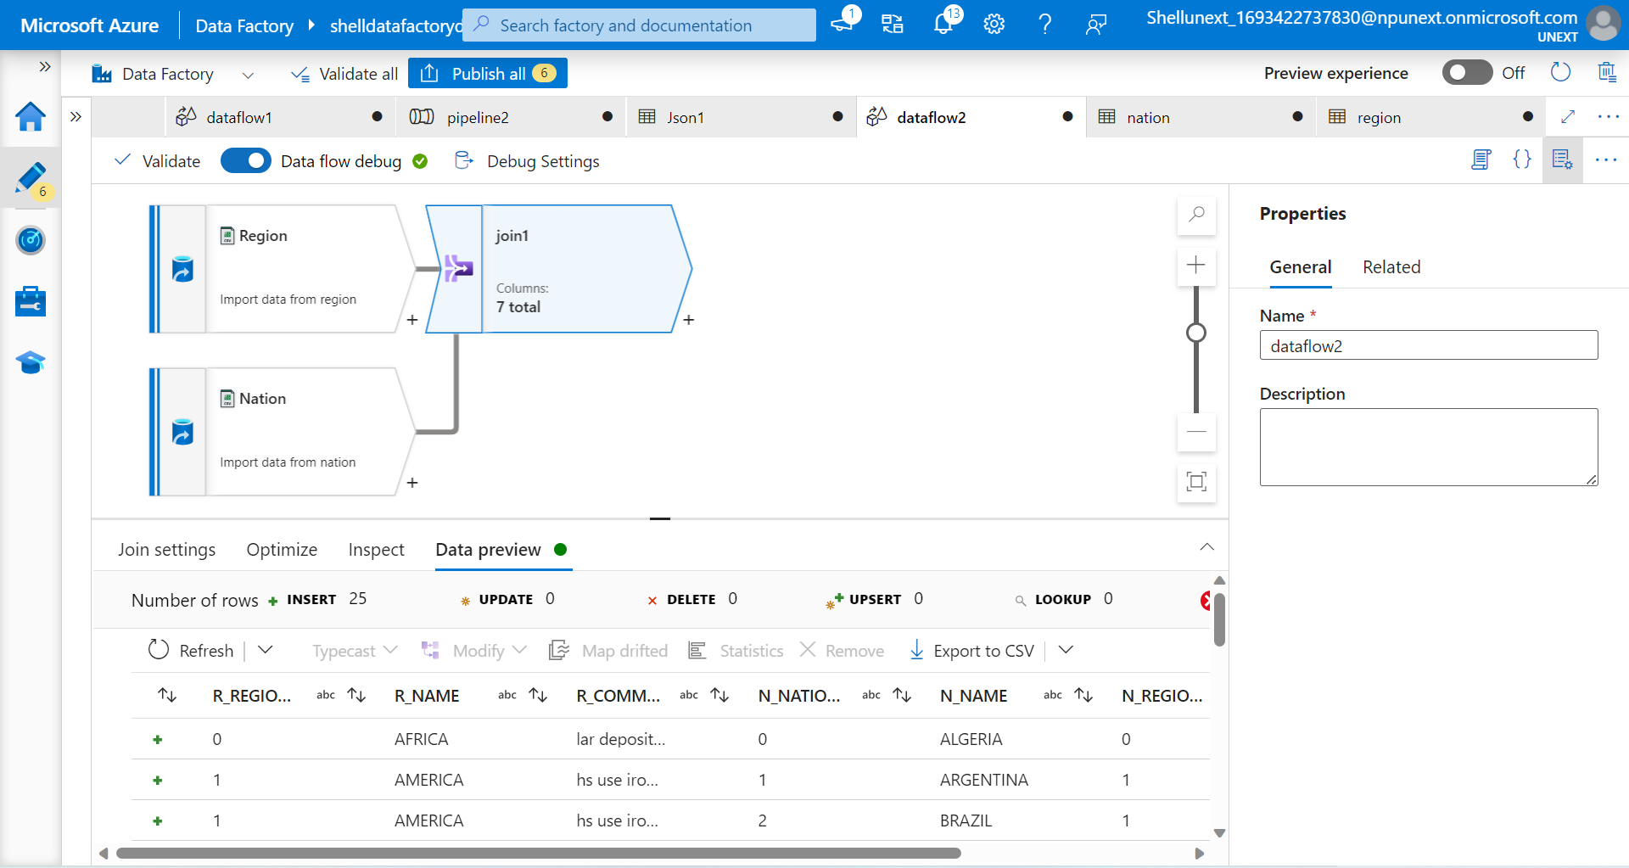
Join activity in Azure Data Factory

Slide 14
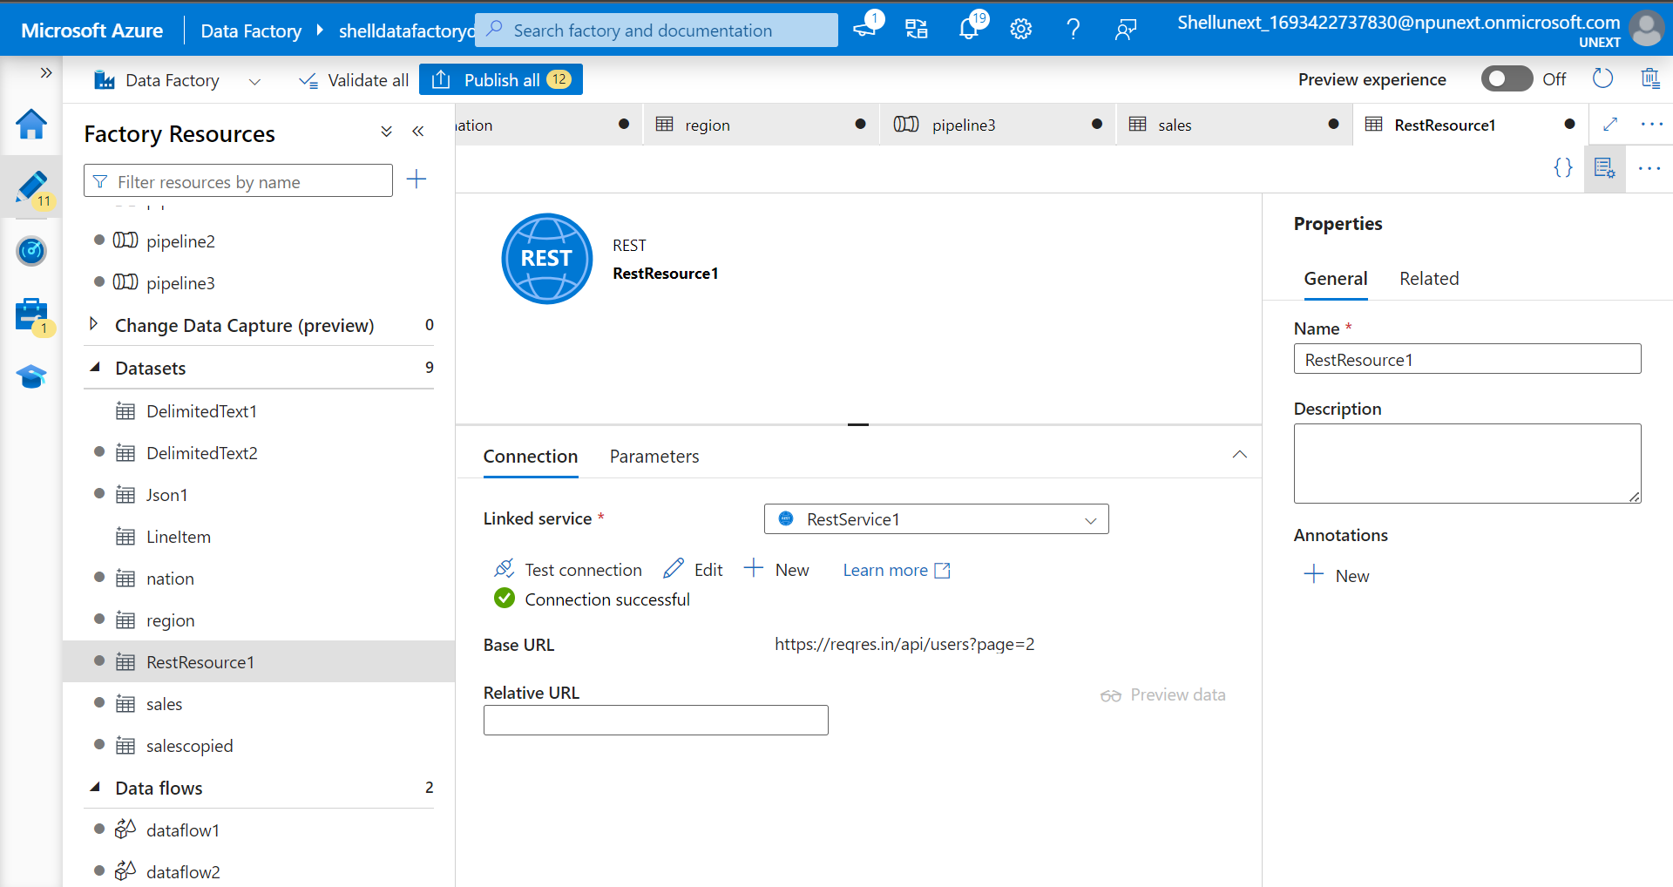
REST API dataset in Azure Data Factory

Slide 15
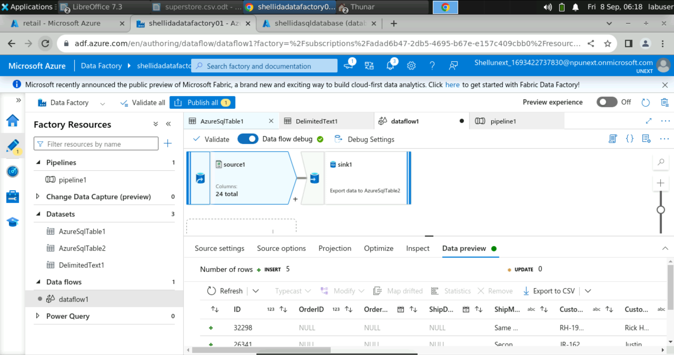
Azure Data Factory (08/09/2023)
Key Learnings:
Use Azure SQL Database with Data Factory

Slide 16
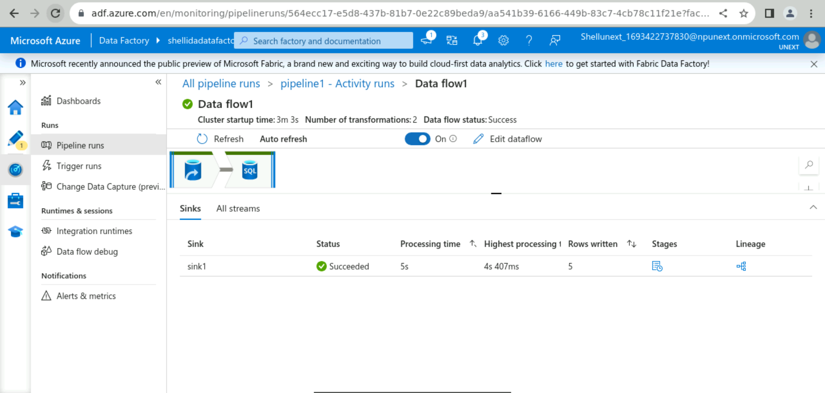
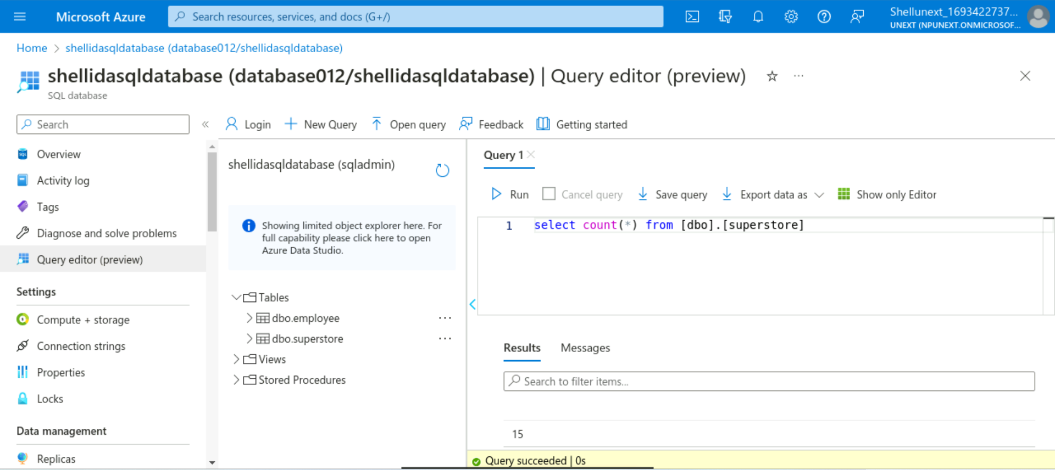
Use Azure SQL Database with Data Factory

Slide 17
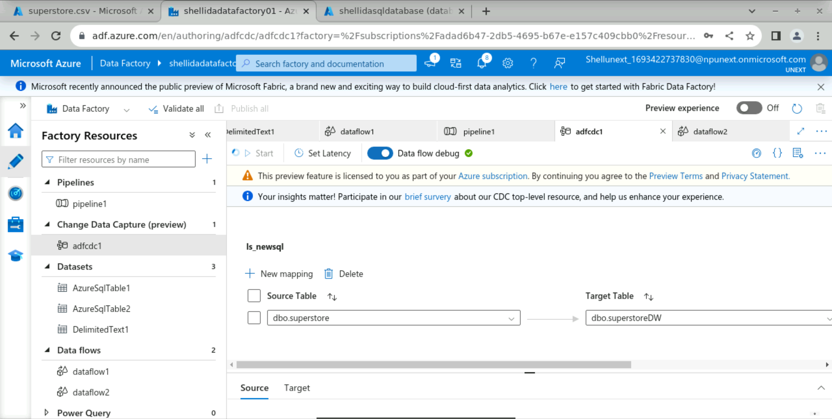
Change Data Capture for data increments

Slide 18
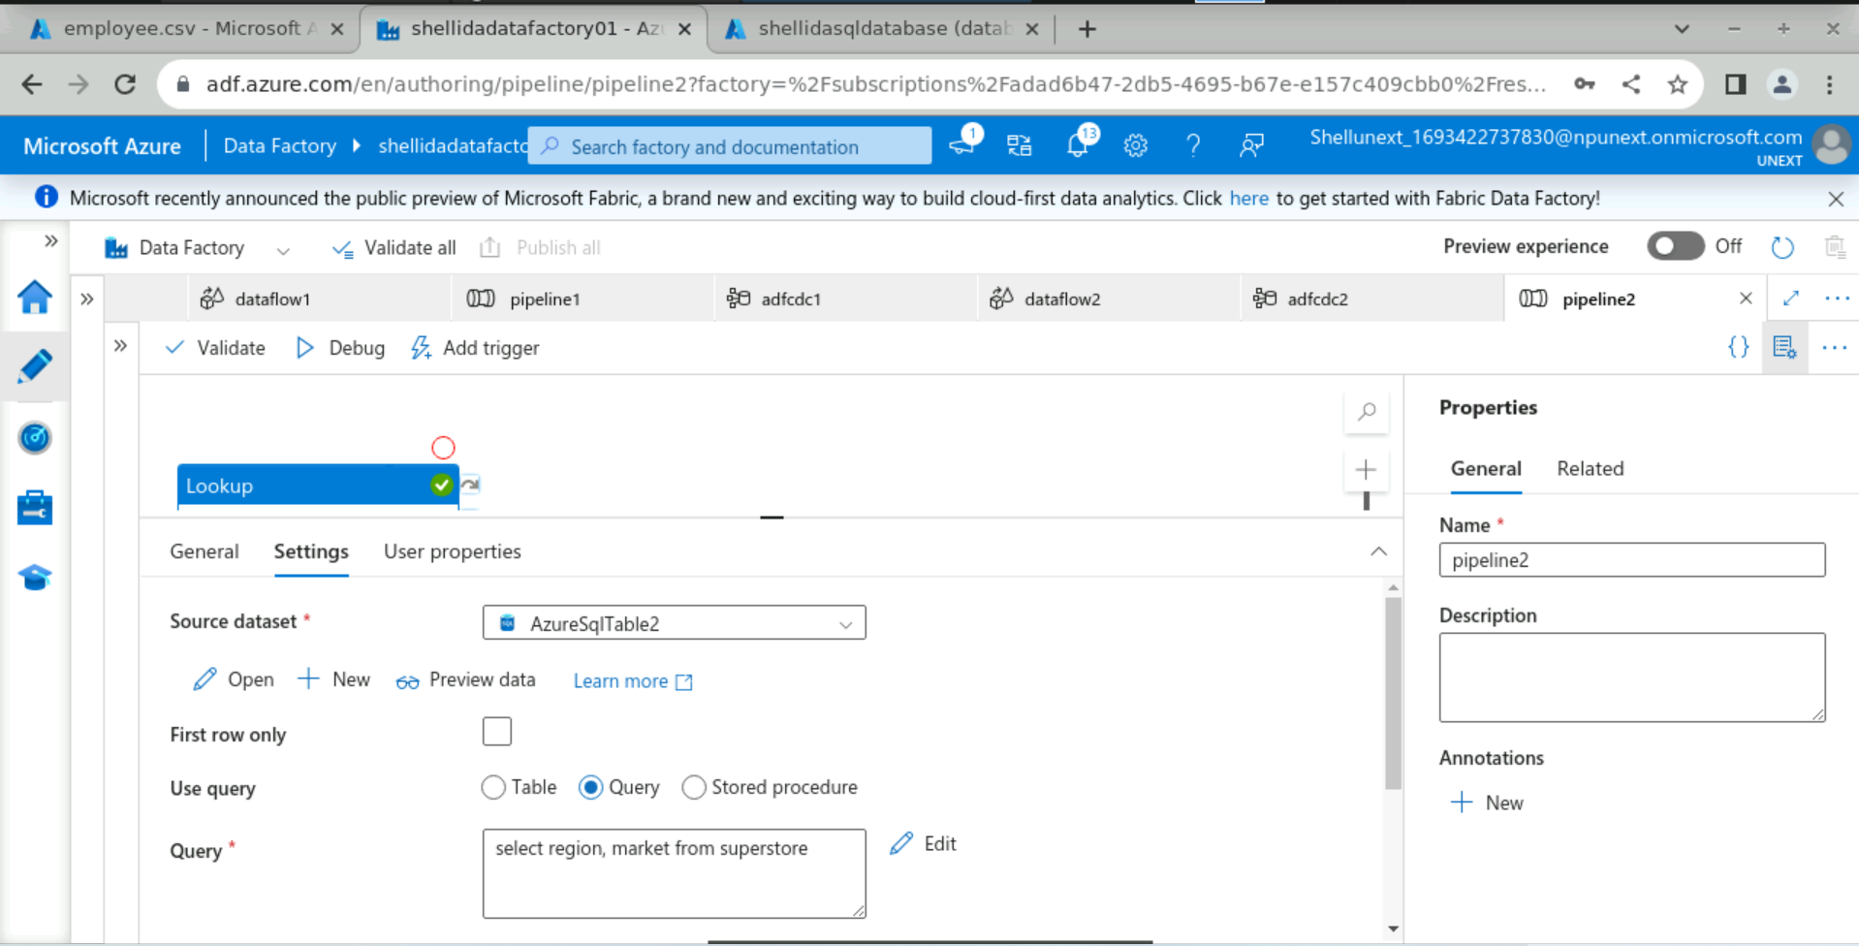
Running SQL queries through Data Factory

Slide 19
Thank You

